Slide 1
Generating Stories by Prompting Pre-trained Language Models Paresh Pradhan Student ID: 1038004 Final Thesis Presentation for Master of Science in Machine Learning & Artificial Intelligence Liverpool John Moores University & upGrad March 2023

Slide 2
Introduction
Automatic Story Generation (ASG) is the task of automatically generating coherent stories, given a set of premises or a brief summary.
Controllable Story Generation is an extension of ASG, where the generation is controlled based on pre-defined structures or rules.
Large Language Models (LLMs) can generate text indistinguishable from humans. However, for open-ended tasks such as story-generation, there are problems like repetition, topic-drift, and self-contradiction.
Stories generated using language models have shown to lack discourse coherence, global planning, common-sense knowledge and tend to repeat sentences in long-form generation.
Some works have tried to resolve these issues by using explicit content planning techniques such as story-prompts, keywords & keyphrases, semantic frames and summaries. But these works require fine-tuning.
The new paradigm of Prompt-Learning has shown promise in text generation tasks without the need for fine-tuning.
This work explores techniques such as Prompt-Learning, In-Context Learning and Instruction Tuning for generate stories using LLMs.
The generated stories are evaluated across different criteria including size and type of the Language Models and using different evaluation metrics – both qualitative and quantitative.

Slide 3
Research Questions & Objectives
Research Questions:
The approaches for controllable story generation require fine-tuning of PLMs. Can Prompt-based learning be used to generate stories in a Zero-Shot or Few-Shot manner without fine-tuning?
Prompt-based learning has been used to generate text. Can this be extended to generate stories with characters and a consistent plot?
The previous methods largely use GPT2 as the base Language Model. Can using the latest generation GPT3 (or alternatives) improve the text generation capabilities?
What are the best performing models available for this task, both commercially and open-source?
Aim:
This work tries to use Prompt-Learning and explore the Zero-Shot & Few-shot capabilities of GPT3 (& alternatives) for controllable story generation task.
Objectives:
To conduct a comprehensive review of available literature with regards to Automatic story generation and Prompt-Learning.
To explore the viability and then develop a method to generate stories using Prompt-Learning.
To evaluate the generated stories using automated story generation evaluation metrics.
To compare the developed method against state-of-the-art models/methods.

Slide 4
Related Works – Automated Story Generation
Older works
Structural Models - Li et al., 2013
Planning based models - Eger et al., 2015
Statistical Models - Jain et al., 2017
Seq2Seq Encoder-Decoder Models
RNN/LSTM Models - Choi et al., 2016; Tambwekar et al., 2018
Attention based Models - Ammanabrolu et al., 2019; Fan et al., 2018; Yao et al., 2019; Xu et al., 2018; Chen et al., 2021
Transformer based Models – Araz, 2020
GPT2 PLM
See et al., 2019; Ott et al., 2019; Guan et al., 2020; Sun et al., 2020; Fang et al., 2021
GPT3 & others
Notes:
References:
Ammanabrolu, P., Tien, E., Cheung, W., Luo, Z., Ma, W., Martin, L.J. and Riedl, M.O., (2019) Guided Neural Language Generation for Automated Storytelling. [online] pp.46–55. Available at: https://aclanthology.org/W19-3405 [Accessed 5 Jan. 2023].
Araz, K., (2020) Transformer Neural Networks for Automated Story Generation. Dissertations. [online] Available at: https://arrow.tudublin.ie/scschcomdis/211 [Accessed 5 Jan. 2023].
Chen, G., Liu, Y., Luan, H., Zhang, M., Liu, Q. and Sun, M., (2021) Learning to Generate Explainable Plots for Neural Story Generation. IEEE/ACM Transactions on Audio Speech and Language Processing, 29, pp.585–593.
Choi, Y., Kim, S. and Lee, J.H., (2016) Recurrent Neural Network for Storytelling. Proceedings - 2016 Joint 8th International Conference on Soft Computing and Intelligent Systems and 2016 17th International Symposium on Advanced Intelligent Systems, SCIS-ISIS 2016, pp.841–845.
Eger, M., Potts, C.M., Barot, C. and Young, R.M., (2015) Plotter: Operationalizing the Master Book of All Plots. Proceedings of the AAAI Conference on Artificial Intelligence and Interactive Digital Entertainment, [online] 114, pp.30–33. Available at: https://ojs.aaai.org/index.php/AIIDE/article/view/12835 [Accessed 9 Feb. 2023].
Fan, A., Lewis, M. and Dauphin, Y., (2018) Hierarchical Neural Story Generation. ACL 2018 - 56th Annual Meeting of the Association for Computational Linguistics, Proceedings of the Conference (Long Papers), [online] 1, pp.889–898. Available at: https://arxiv.org/abs/1805.04833v1 [Accessed 9 Feb. 2023].
Fang, L., Zeng, T., Liu, C., Bo, L., Dong, W. and Chen, C., (2021) Outline to Story: Fine-grained Controllable Story Generation from Cascaded Events. Available at: https://arxiv.org/abs/2101.00822
Guan, J., Huang, F., Zhao, Z., Zhu, X. and Huang, M., (2020) A Knowledge-Enhanced Pretraining Model for Commonsense Story Generation. Transactions of the Association for Computational Linguistics, [online] 8, pp.93–108. Available at: https://aclanthology.org/2020.tacl-1.7 [Accessed 31 Aug. 2022].
Jain, P., Agrawal, P., Mishra, A., Sukhwani, M., Laha, A. and Sankaranarayanan, K., (2017) Story Generation from Sequence of Independent Short Descriptions. [online] 7. Available at: https://arxiv.org/abs/1707.05501v2 [Accessed 9 Feb. 2023].
Li, B., Lee-Urban, S., Johnston, G. and Riedl, M.O., (2013) Story Generation with Crowdsourced Plot Graphs. Proceedings of the AAAI Conference on Artificial Intelligence, [online] 271, pp.598–604. Available at: https://ojs.aaai.org/index.php/AAAI/article/view/8649 [Accessed 9 Feb. 2023].
Ott, M., Edunov, S., Baevski, A., Fan, A., Gross, S., Ng, N., Grangier, D. and Auli, M., (2019) fairseq: A Fast, Extensible Toolkit for Sequence Modeling. NAACL HLT 2019 - 2019 Conference of the North American Chapter of the Association for Computational Linguistics: Human Language Technologies - Proceedings of the Demonstrations Session, [online] pp.48–53. Available at: https://arxiv.org/abs/1904.01038v1 [Accessed 10 Feb. 2023].
See, A., Pappu, A., Saxena, R., Yerukola, A. and Manning, C.D., (2019) Do Massively Pretrained Language Models Make Better Storytellers? CoNLL 2019 - 23rd Conference on Computational Natural Language Learning, Proceedings of the Conference, [online] pp.843–861. Available at: https://arxiv.org/abs/1909.10705v1 [Accessed 10 Feb. 2023].
Sun, X., Fan, C., Sun, Z., Meng, Y., Wu, F. and Li, J., (2020) Summarize, Outline, and Elaborate: Long-Text Generation via Hierarchical Supervision from Extractive Summaries. [online] Available at: https://arxiv.org/abs/2010.07074v2 [Accessed 23 Oct. 2022].
Tambwekar, P., Dhuliawala, M., Martin, L.J., Mehta, A., Harrison, B. and Riedl, M.O., (2018) Controllable Neural Story Plot Generation via Reward Shaping. IJCAI International Joint Conference on Artificial Intelligence, [online] 2019-August, pp.5982–5988. Available at: http://arxiv.org/abs/1809.10736 [Accessed 10 Feb. 2023].
Xu, J., Ren, X., Zhang, Y., Zeng, Q., Cai, X. and Sun, X., (2018) A Skeleton-Based Model for Promoting Coherence Among Sentences in Narrative Story Generation. Proceedings of the 2018 Conference on Empirical Methods in Natural Language Processing, EMNLP 2018, [online] pp.4306–4315. Available at: https://arxiv.org/abs/1808.06945v2 [Accessed 10 Feb. 2023].
Yao, L., Peng, N., Weischedel, R., Knight, K., Zhao, D. and Yan, R., (2019) Plan-and-Write: Towards Better Automatic Storytelling. Proceedings of the AAAI Conference on Artificial Intelligence, [online] 3301, pp.7378–7385. Available at: https://ojs.aaai.org/index.php/AAAI/article/view/4726 [Accessed 10 Feb. 2023].

Slide 5
Related Works – Story Evaluation
Statistical Metrics
Perplexity
Pointwise Mutual Information (PMI)
Embedding based Metrics
Cosine similarity metrics
Skip Thoughts Cosine Similarity
Embedding Average Cosine Similarity
BERTScore
Qualitative Metrics
Lexical Cohesion, Style Matching, Entity Co-reference, Grammatical Correctness, Event Progression, Narrative structure, Local Contextuality, Believability, Diversity
Human Evaluation
Manual evaluation by Human Experts or Annotators
N-gram overlap
BLEU, ROUGE, CIDEr and METEOR

Slide 6
Related Works – Prompt-based Learning
Design Considerations for Prompting
Pre-trained Model Choice
Prompt Engineering
Prompt-based Training Strategies
Liu et al., 2021b
Controlled Generation with Prompting
Styling Rules, Domain Specification, and Length Specifications
Keywords, Key Phrases, Sentences to decide content
Few-Shot & Zero-Shot Generation with In-Context Learning
Kikuchi et al., 2016; Sennrich et al., 2016; Chu et al., 2017; Fan et al., 2018
Grangier and Auli, 2017; Saito et al., 2020; Liu and Nikolic, 2021
Fully Supervised Learning Paradigm
Kotsiantis, 2007; Collobert et al., 2011; Bengio et al., 2013; Hochreiter and Schmidhuber, 1997; Bahdanau et al., 2014; Chung et al., 2014; Kalchbrenner et al., 2014; Vaswani et al., 2017
Pre-train and Fine-Tune Paradigm
Peters et al., 2018; Dong et al., 2019a; Yang et al., 2019; Lewis et al., 2020; Zhang et al., 2020
Pre-train, Prompt & Predict Paradigm
Petroni et al., 2019; Radford et al., 2019; Brown et al., 2020; Gao et al., 2020c; Raffel et al., 2020; Schick and Schütze, 2020a; Sun et al., 2021
Notes:
References:
Bahdanau, D., Cho, K.H. and Bengio, Y., (2014) Neural Machine Translation by Jointly Learning to Align and Translate. 3rd International Conference on Learning Representations, ICLR 2015 - Conference Track Proceedings. [online] Available at: https://arxiv.org/abs/1409.0473v7 [Accessed 12 Dec. 2022].
Bengio, Y., Courville, A. and Vincent, P., (2013) Representation learning: A review and new perspectives. IEEE Transactions on Pattern Analysis and Machine Intelligence, 358, pp.1798–1828.
Brown, T.B., Mann, B., Ryder, N., Subbiah, M., Kaplan, J., Dhariwal, P., Neelakantan, A., Shyam, P., Sastry, G., Askell, A., Agarwal, S., Herbert-Voss, A., Krueger, G., Henighan, T., Child, R., Ramesh, A., Ziegler, D.M., Wu, J., Winter, C., Hesse, C., Chen, M., Sigler, E., Litwin, M., Gray, S., Chess, B., Clark, J., Berner, C., Mccandlish, S., Radford, A., Sutskever, I. and Amodei, D., (2020) Language Models are Few-Shot Learners. Advances in Neural Information Processing Systems, [online] 33, pp.1877–1901. Available at: https://commoncrawl.org/the-data/ [Accessed 10 Feb. 2023].
Chu, C., Dabre, R. and Kurohashi, S., (2017) An Empirical Comparison of Domain Adaptation Methods for Neural Machine Translation. ACL 2017 - 55th Annual Meeting of the Association for Computational Linguistics, Proceedings of the Conference (Long Papers), [online] 2, pp.385–391. Available at: https://aclanthology.org/P17-2061 [Accessed 10 Feb. 2023].
Chung, J., Gulcehre, C., Cho, K. and Bengio, Y., (2014) Empirical Evaluation of Gated Recurrent Neural Networks on Sequence Modeling. [online] Available at: https://arxiv.org/abs/1412.3555v1 [Accessed 12 Dec. 2022].
Collobert, R., Weston, J., Com, J., Karlen, M., Kavukcuoglu, K. and Kuksa, P., (2011) Natural Language Processing (Almost) from Scratch. Journal of Machine Learning Research, 12, pp.2493–2537.
Dong, L., Yang, N., Wang, W., Wei, F., Liu, X., Wang, Y., Gao, J., Zhou, M. and Hon, H.-W., (2019a) Unified Language Model Pre-training for Natural Language Understanding and Generation. Advances in Neural Information Processing Systems, [online] 32. Available at: https://github.com/microsoft/unilm. [Accessed 12 Dec. 2022].
Fan, A., Lewis, M. and Dauphin, Y., (2018) Hierarchical Neural Story Generation. ACL 2018 - 56th Annual Meeting of the Association for Computational Linguistics, Proceedings of the Conference (Long Papers), [online] 1, pp.889–898. Available at: https://arxiv.org/abs/1805.04833v1 [Accessed 9 Feb. 2023].
Gao, T., Fisch, A. and Chen, D., (2020c) Making Pre-trained Language Models Better Few-shot Learners. ACL-IJCNLP 2021 - 59th Annual Meeting of the Association for Computational Linguistics and the 11th International Joint Conference on Natural Language Processing, Proceedings of the Conference, [online] pp.3816–3830. Available at: https://arxiv.org/abs/2012.15723v2 [Accessed 10 Feb. 2023].
Grangier, D. and Auli, M., (2017) QuickEdit: Editing Text & Translations by Crossing Words Out. NAACL HLT 2018 - 2018 Conference of the North American Chapter of the Association for Computational Linguistics: Human Language Technologies - Proceedings of the Conference, [online] 1, pp.272–282. Available at: https://arxiv.org/abs/1711.04805v2 [Accessed 10 Feb. 2023].
Hochreiter, S. and Schmidhuber, J., (1997) Long Short-Term Memory. Neural Computation, 98, pp.1735–1780.
Kalchbrenner, N., Grefenstette, E. and Blunsom, P., (2014) A Convolutional Neural Network for Modelling Sentences. 52nd Annual Meeting of the Association for Computational Linguistics, ACL 2014 - Proceedings of the Conference, [online] 1, pp.655–665. Available at: https://arxiv.org/abs/1404.2188v1 [Accessed 12 Dec. 2022].
Kikuchi, Y., Neubig, G., Sasano, R., Takamura, H. and Okumura, M., (2016) Controlling Output Length in Neural Encoder-Decoders. EMNLP 2016 - Conference on Empirical Methods in Natural Language Processing, Proceedings, [online] pp.1328–1338. Available at: https://arxiv.org/abs/1609.09552v1 [Accessed 10 Feb. 2023].
Kotsiantis, S.B., (2007) Supervised Machine Learning: A Review of Classification Techniques. Informatica, 31, pp.249–268.
Lewis, M., Liu, Y., Goyal, N., Ghazvininejad, M., Mohamed, A., Levy, O., Stoyanov, V., Zettlemoyer, L. and Ai, F., (2020) BART: Denoising Sequence-to-Sequence Pre-training for Natural Language Generation, Translation, and Comprehension. [online] pp.7871–7880. Available at: https://aclanthology.org/2020.acl-main.703 [Accessed 13 Feb. 2023].
Liu, P., Yuan, W., Fu, J., Jiang, Z., Hayashi, H. and Neubig, G., (2021b) Pre-train, Prompt, and Predict: A Systematic Survey of Prompting Methods in Natural Language Processing. ACM Computing Surveys. [online] Available at: https://arxiv.org/abs/2107.13586v1 [Accessed 10 Nov. 2022].
Liu, R. and Nikolic, P.K., (2021) Mutltimodal AI Companion for Interactive Fairytale Co-creation. [online] Available at: https://arxiv.org/abs/2112.00331v1 [Accessed 6 Sep. 2022].
Peters, M.E., Neumann, M., Iyyer, M., Gardner, M., Clark, C., Lee, K. and Zettlemoyer, L., (2018) Deep Contextualized Word Representations. NAACL HLT 2018 - 2018 Conference of the North American Chapter of the Association for Computational Linguistics: Human Language Technologies - Proceedings of the Conference, [online] 1, pp.2227–2237. Available at: https://aclanthology.org/N18-1202 [Accessed 12 Dec. 2022].
Petroni, F., Rocktäschel, T., Lewis, P., Bakhtin, A., Wu, Y., Miller, A.H. and Riedel, S., (2019) Language Models as Knowledge Bases? EMNLP-IJCNLP 2019 - 2019 Conference on Empirical Methods in Natural Language Processing and 9th International Joint Conference on Natural Language Processing, Proceedings of the Conference, [online] pp.2463–2473. Available at: https://arxiv.org/abs/1909.01066v2 [Accessed 10 Feb. 2023].
Radford, A., Wu, J., Child, R., Luan, D., Amodei, D. and Sutskever, I., (2019) Language Models are Unsupervised Multitask Learners. [online] Available at: https://d4mucfpksywv.cloudfront.net/better-language-models/language-models.pdf [Accessed 10 Feb. 2023].
Raffel, C., Shazeer, N., Roberts, A., Lee, K., Narang, S., Matena, M., Zhou, Y., Li, W. and Liu, P.J., (2020) Exploring the limits of transfer learning with a unified text-to-text transformer. The Journal of Machine Learning Research, [online] 21, pp.1–67. Available at: https://dl.acm.org/doi/10.5555/3455716.3455856 [Accessed 10 Feb. 2023].
Saito, I., Nishida, K., Nishida, K. and Tomita, J., (2020) Abstractive Summarization with Combination of Pre-trained Sequence-to-Sequence and Saliency Models. [online] Available at: https://arxiv.org/abs/2003.13028v1 [Accessed 10 Feb. 2023].
Schick, T. and Schütze, H., (2020a) Exploiting Cloze Questions for Few Shot Text Classification and Natural Language Inference. EACL 2021 - 16th Conference of the European Chapter of the Association for Computational Linguistics, Proceedings of the Conference, [online] pp.255–269. Available at: https://arxiv.org/abs/2001.07676v3 [Accessed 10 Feb. 2023].
Sennrich, R., Haddow, B. and Birch, A., (2016) Controlling Politeness in Neural Machine Translation via Side Constraints. [online] pp.35–40. Available at: http://www.opensubtitles.org [Accessed 10 Feb. 2023].
Sun, Y., Wang, S., Feng, S., Ding, S., Pang, C., Shang, J., Liu, J., Chen, X., Zhao, Y., Lu, Y., Liu, W., Wu, Z., Gong, W., Liang, J., Shang, Z., Sun, P., Liu, W., Ouyang, X., Yu, D., Tian, H., Wu, H. and Wang, H., (2021) ERNIE 3.0: Large-scale Knowledge Enhanced Pre-training for Language Understanding and Generation. [online] Available at: https://arxiv.org/abs/2107.02137v1 [Accessed 10 Feb. 2023].
Vaswani, A., Brain, G., Shazeer, N., Parmar, N., Uszkoreit, J., Jones, L., Gomez, A.N., Kaiser, Ł. and Polosukhin, I., (2017) Attention is All you Need. Advances in Neural Information Processing Systems, 30.
Yang, Z., Dai, Z., Yang, Y., Carbonell, J., Salakhutdinov, R.R. and Le, Q. v., (2019) XLNet: Generalized Autoregressive Pretraining for Language Understanding. Advances in Neural Information Processing Systems, [online] 32. Available at: https://github.com/zihangdai/xlnet [Accessed 12 Dec. 2022].
Zhang, J., Zhao, Y., Saleh, M. and Liu, P.J., (2020) PEGASUS: Pre-training with Extracted Gap-sentences for Abstractive Summarization. Available at: https://proceedings.mlr.press/v119/zhang20ae.html [Accessed 12 Dec. 2022].

Slide 7
Challenges
Challenges in Automatic Story Generation
Dispersion
Domain knowledge
Pre-trained language models
Story interestingness
Objective evaluation
Challenges in Prompting
Prompt Design
Answer Engineering
Selection of Tuning Strategy
Selection of Pre-trained Models
Combination of Different Paradigms
Calibration of Prompting Methods

Slide 8
Algorithms & Techniques
n-Shot Learning
Few-Shot Learning
Few reference samples (~10)
One-Shot Learning
One reference sample
Zero-Shot Learning
Zero reference samples
Pre-Trained Language Models
GPT-2
Second generation of Generative Pretrained Transformer by OpenAI (124M params). (Radford et al., 2019)
GPT-3
Third generation of GPT (upto 175B params). (Brown et al., 2020)
GPT-3.5
GPT-3 + Instruction Tuning. Based on InstructGPT. (Ouyang et al., 2022; OpenAI, 2023b)
OPT
Facebook’s version of GPT-3 (upto 175B params). (Zhang et al., 2022)
OPT-IML
Instruction tuned version of OPT. (30B params)
BLOOM
Open-source model trained by 1000+ researchers. Similar to GPT-3 in architecture & scale. (BigScience et al., 2022)
BLOOMZ
Instruction tuned version of BLOOM. Multi-task & Cross-Lingual. (Muennighoff et al., 2022)
LaMDA & PaLM
Large language models by Google. (Thoppilan et al., 2022; Chowdhery et al., 2022)
Notes:
References:
BigScience, Le Scao, T., Fan, A., Akiki, C., Pavlick, E., Ili, S., Hesslow, D., Castagné, R., Sasha Luccioni, A., Yvon, F., Gallé, M., Tow, J., Rush, A.M., Biderman, S., Webson, A., SasankaAmmanamanchi, P., Wang, T., Sagot, B., Muennighoff, N., Villanova del Moral, A., Ruwase, O., Bawden, R., Bekman, S., McMillan-Major, A., Wolf, T., Beltagy, I., Nguyen, H., Saulnier, L., Tan, S., Ortiz Suarez, P., Sanh, V., Laurençon, H., Jernite, Y., Launay, J., Mitchell, M., Raffel Dataset Aaron Gokaslan, C., Simhi, A., Soroa, A., Fikri Aji, A., Alfassy, A., Rogers, A., KreisbergNitzav, A., Xu, C., Mou, C., Emezue, C., Klamm, C., Leong, C., Raffel, C., van Strien, D., IfeoluwaAdelani, D., Radev, D., González Pon-ferrada, E., Levkovizh, E., Kim, E., Bar Natan, E., De Toni, F., Dupont, G., Kruszewski, G., Pistilli, G., Elsahar, H., Benyamina, H., Tran, H., Yu, I., Abdulmumin, I., Johnson, I., Gonzalez-Dios, I., de la Rosa, J., Chim, J., Dodge, J., Zhu, J., Chang, J., Frohberg, J., Tobing, J., Bhattachar-jee, J., Almubarak, K., Chen, K., Lo, K., Von Werra, L., Weber, L., Phan, L., Ben allal, L., Tanguy, L., Dey, M., Romero Muñoz, M., Masoud, M., Grandury, M., Huang, M., Coavoux, M., Singh, M., Tian-Jian Jiang, M., Chien Vu, M., Jauhar, M.A., Ghaleb, M., Subramani, N., Kassner, N., Khamis, N., Nguyen, O., Espejel, O., de Gibert, O., Villegas, P., Henderson, P., Colombo, P., Amuok, P., Lhoest, Q., Harliman, R., Bommasani, R., Luis López, R., Ribeiro, R., Osei, S., Pyysalo, S., Nagel, S., Bose, S., Hassan Muhammad, S., Sharma, S., Longpre, S., Nikpoor, S., Silberberg, S., Pai, S., Zink, S., Timponi Torrent, T., Schick, T., Thrush, T., Danchev, V., Nikoulina, V., Laippala, V., Lepercq, V., Prabhu, V., Alyafeai, Z., Talat Tokenization Arun Raja, Z., Heinzerling, B., Si, C., Emre Ta, D., Salesky, E., Mielke, S.J., Lee, W.Y., Sharma, A., Santilli, A., Chaffin, A., Stiegler, A., Raja, A., Datta, D., Szczechla, E., Chhablani, G., Wang, H., Pandey, H., Strobelt, H., Alan Fries, J., Rozen, J., Gao, L., Sutawika, L., Saiful Bari, M., Al-shaibani, M.S., Manica, M., Nayak, N., Teehan, R., Albanie, S., Shen, S., Ben-David, S., Bach, S.H., Kim, T., Bers, T., Fevry, T., Neeraj, T., Thakker, U., Raunak, V., Tang, X., Yong, Z.-X., Sun, Z., Brody, S., Uri, Y., Tojarieh, H., Roberts, A., Won Chung, H., Tae, J., Phang, J., Muen-nighoff, N., Press, O., Li, C., Narayanan, D., Bourfoune, H., Casper, J., Rasley, J., Ryabinin, M., Mishra, M., Zhang, M., Shoeybi, M., Peyrounette, M., Patry, N., Tazi, N., Sanseviero, O., von Platen, P., Cor-nette, P., François Lavallée, P., Lacroix, R., Rajbhandari, S., Gandhi, S., Smith, S., Requena, S., Patil, S., Dettmers, T., Baruwa, A., Singh, A., Cheveleva, A., Ligozat, A.-L., Subramonian, A., Névéol, A., Lovering, C., Garrette, D., Tunuguntla, D., Reiter, E., Taktasheva, E., Voloshina, E., Bogdanov, E., Indra Winata, G., Schoelkopf, H., Kalo, J.-C., Novikova, J., Zosa Forde, J., Clive, J., Kasai, J., Kawamura, K., Hazan, L., Carpuat, M., Clinciu, M., Kim, N., Cheng, N., Serikov, O., Antverg, O., van der Wal, O., Zhang, R., Zhang, R., Gehrmann, S., Mirkin, S., Pais, S., Shavrina, T., Scialom, T., Yun, T., Limisiewicz, T., Rieser, V., Protasov, V., Mikhailov, V., Pruksachatkun, Y., Belinkov, Y., Bamberger, Z., Kasner, Z., Talat, Z., Gokaslan, A., Rueda, A., Pestana, A., Feizpour, A., Khan, A., Faranak, A., Santos, A., Hevia, A., Unldreaj, A., Aghagol, A., Abdollahi, A., Tammour, A., HajiHosseini, A., Behroozi, B., Ajibade, B., Saxena, B., Muñoz Ferrandis, C., Contractor, D., Lansky, D., David, D., Kiela, D., Nguyen, D.A., Tan, E., Baylor, E., Ozoani, E., Mirza, F., Ononiwu, F., Rezanejad, H., Jones, H., Bhattacharya, I., Solaiman, I., Sedenko, I., Nejadgholi, I., Passmore, J., Seltzer, J., Bonis Sanz, J., Dutra, L., Samagaio, M., Elbadri, M., Ma-soud, M., Mieskes, M., Gerchick, M., Akinlolu, M., McKenna, M., Qiu, M., Ghauri, M., Burynok, M., Abrar, N., Rajani, N., Elkott, N., Fahmy, N., Samuel, O., An, R., Kromann, R., Hao, R., Alizadeh, S., Shubber, S., Wang, S., Roy, S., Viguier, S., Le, T., Oyebade, T., Le, T., Yang, Y., Nguyen, Z., Yong Applications Abhinav Ramesh Kashyap, Z.-X., Palasciano, A., Callahan, A., Shukla, A., Miranda-Escalada, A., Singh, A., Beilharz, B., Wang, B., Brito, C., Muñoz Ferrandis, B., Zhou, C., Jain, C., Xu, C., Fourrier, C., León Periñán, D., Molano, D., Yu, D., Manjavacas, E., Barth, F., Fuhrimann, F., Altay, G., Bayrak, G., Burns, G., Vrabec, H.U., Bello, I., Dash, I., Kang, J., Giorgi, J., Golde, J., David Posada, J., RangasaiSivaraman, K., Bulchandani, L., Liu, L., Shinzato, L., Hahn de Bykhovetz, M., Takeuchi, M., Pàmies, M., Castillo, M.A., Nezhurina, M., Sänger, M., Samwald, M., Cullan, M., Weinberg, M., De Wolf, M., Mihaljcic, M., Liu, M., Freidank, M., Kang, M., Seelam, N., Dahlberg, N., Michio Broad, N., Muellner, N., Fung, P., Haller, P., Chandrasekhar, R., Eisenberg, R., Martin, R., Canalli, R., Su, R., Su, R., Cahyawijaya, S., Garda, S., Deshmukh, S.S., Mishra, S., Kiblawi, S., Ott, S., Sang-aroonsiri, S., Kumar, S., Schweter, S., Bharati, S., Laud, T., Gigant, T., Kainuma, T., Kusa, W., Labrak, Y., Shailesh Bajaj, Y., Venkatraman, Y., Xu, Y., Xu, Y., Xu, Y., Tan, Z., Xie, Z., Ye, Z., Bras, M. and Belkada, Y., (2022) BLOOM: A 176B-Parameter Open-Access Multilingual Language Model. [online] Available at: https://arxiv.org/abs/2211.05100v2 [Accessed 16 Feb. 2023].
Brown, T.B., Mann, B., Ryder, N., Subbiah, M., Kaplan, J., Dhariwal, P., Neelakantan, A., Shyam, P., Sastry, G., Askell, A., Agarwal, S., Herbert-Voss, A., Krueger, G., Henighan, T., Child, R., Ramesh, A., Ziegler, D.M., Wu, J., Winter, C., Hesse, C., Chen, M., Sigler, E., Litwin, M., Gray, S., Chess, B., Clark, J., Berner, C., Mccandlish, S., Radford, A., Sutskever, I. and Amodei, D., (2020) Language Models are Few-Shot Learners. Advances in Neural Information Processing Systems, [online] 33, pp.1877–1901. Available at: https://commoncrawl.org/the-data/ [Accessed 10 Feb. 2023].
Chowdhery, A., Narang, S., Devlin, J., Bosma, M., Mishra, G., Roberts, A., Barham, P., Chung, H.W., Sutton, C., Gehrmann, S., Schuh, P., Shi, K., Tsvyashchenko, S., Maynez, J., Rao, A., Barnes, P., Tay, Y., Shazeer, N., Prabhakaran, V., Reif, E., Du, N., Hutchinson, B., Pope, R., Bradbury, J., Austin, J., Isard, M., Gur-Ari, G., Yin, P., Duke, T., Levskaya, A., Ghemawat, S., Dev, S., Michalewski, H., Garcia, X., Misra, V., Robinson, K., Fedus, L., Zhou, D., Ippolito, D., Luan, D., Lim, H., Zoph, B., Spiridonov, A., Sepassi, R., Dohan, D., Agrawal, S., Omernick, M., Dai, A.M., Pillai, T.S., Pellat, M., Lewkowycz, A., Moreira, E., Child, R., Polozov, O., Lee, K., Zhou, Z., Wang, X., Saeta, B., Diaz, M., Firat, O., Catasta, M., Wei, J., Meier-Hellstern, K., Eck, D., Dean, J., Petrov, S. and Fiedel, N., (2022) PaLM: Scaling Language Modeling with Pathways. [online] Available at: https://arxiv.org/abs/2204.02311v5 [Accessed 16 Feb. 2023].
Muennighoff, N., Wang, T., Sutawika, L., Roberts, A., Biderman, S., Scao, T. Le, Bari, M.S., Shen, S., Yong, Z.-X., Schoelkopf, H., Tang, X., Radev, D., Aji, A.F., Almubarak, K., Albanie, S., Alyafeai, Z., Webson, A., Raff, E. and Raffel, C., (2022) Crosslingual Generalization through Multitask Finetuning. [online] Available at: https://arxiv.org/abs/2211.01786v1 [Accessed 16 Feb. 2023].
OpenAI, (2023b) Model index for researchers - OpenAI API. [online] Available at: https://platform.openai.com/docs/model-index-for-researchers [Accessed 16 Feb. 2023].
Ouyang, L., Wu, J., Jiang, X., Almeida, D., Wainwright, C.L., Mishkin, P., Zhang, C., Agarwal, S., Slama, K., Ray, A., Schulman, J., Hilton, J., Kelton, F., Miller, L., Simens, M., Askell, A., Welinder, P., Christiano, P., Leike, J. and Lowe, R., (2022) Training language models to follow instructions with human feedback. [online] Available at: https://arxiv.org/abs/2203.02155v1 [Accessed 16 Feb. 2023].
Radford, A., Wu, J., Child, R., Luan, D., Amodei, D. and Sutskever, I., (2019) Language Models are Unsupervised Multitask Learners. [online] Available at: https://d4mucfpksywv.cloudfront.net/better-language-models/language-models.pdf [Accessed 10 Feb. 2023].
Thoppilan, R., De Freitas, D., Hall, J., Shazeer, N., Kulshreshtha, A., Cheng, H.-T., Jin, A., Bos, T., Baker, L., Du, Y., Li, Y., Lee, H., Zheng, H.S., Ghafouri, A., Menegali, M., Huang, Y., Krikun, M., Lepikhin, D., Qin, J., Chen, D., Xu, Y., Chen, Z., Roberts, A., Bosma, M., Zhao, V., Zhou, Y., Chang, C.-C., Krivokon, I., Rusch, W., Pickett, M., Srinivasan, P., Man, L., Meier-Hellstern, K., Morris, M.R., Doshi, T., Santos, R.D., Duke, T., Soraker, J., Zevenbergen, B., Prabhakaran, V., Diaz, M., Hutchinson, B., Olson, K., Molina, A., Hoffman-John, E., Lee, J., Aroyo, L., Rajakumar, R., Butryna, A., Lamm, M., Kuzmina, V., Fenton, J., Cohen, A., Bernstein, R., Kurzweil, R., Aguera-Arcas, B., Cui, C., Croak, M., Chi, E. and Le, Q., (2022) LaMDA: Language Models for Dialog Applications. [online] Available at: https://arxiv.org/abs/2201.08239v3 [Accessed 16 Feb. 2023].
Zhang, S., Roller, S., Goyal, N., Artetxe, M., Chen, M., Chen, S., Dewan, C., Diab, M., Li, X., Lin, X.V., Mihaylov, T., Ott, M., Shleifer, S., Shuster, K., Simig, D., Koura, P.S., Sridhar, A., Wang, T. and Zettlemoyer, L., (2022) OPT: Open Pre-trained Transformer Language Models. [online] Available at: https://arxiv.org/abs/2205.01068v4 [Accessed 16 Feb. 2023].

Slide 9
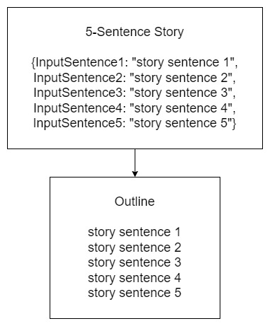
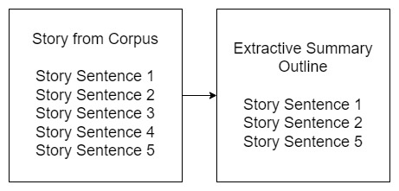
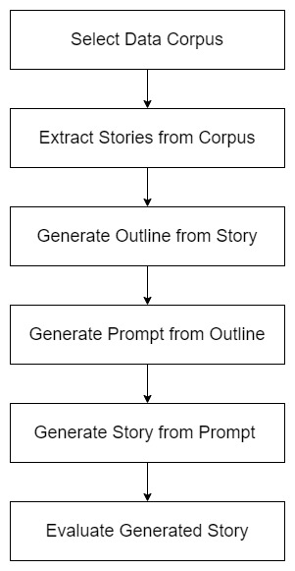
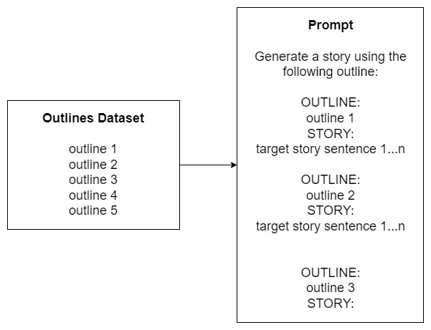
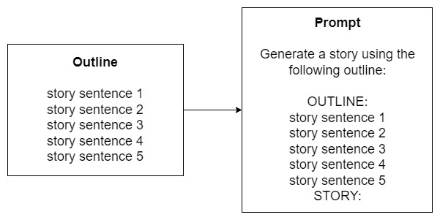
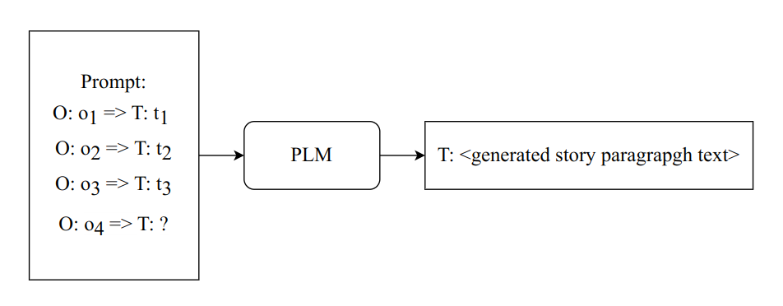
Methodology
ROCStories
WritingPrompts
End-to-End Pipeline

Slide 10
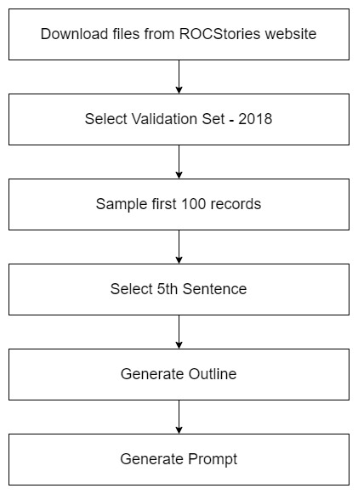
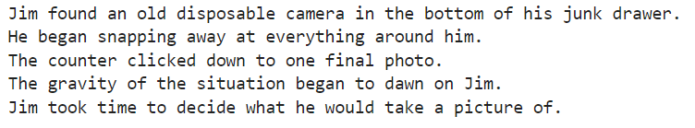
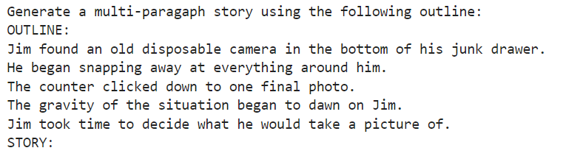
Implementation – Data Preparation
Sample Outline
Sample Prompt

Slide 11
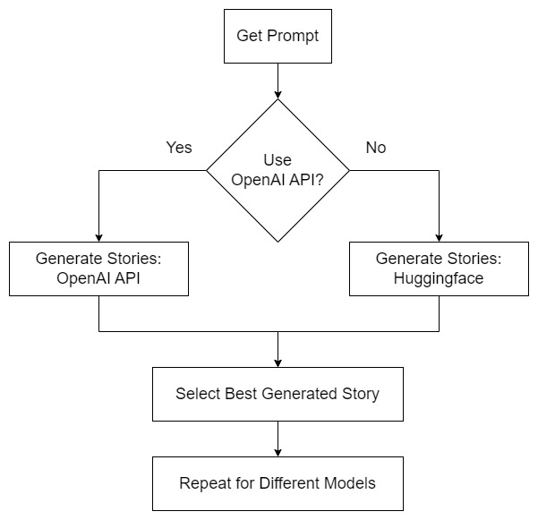
Implementation – Story Generation
Different Generative Models
OpenAI GPT3 - text-ada-001
OpenAI GPT3 - text-babbage-001
OpenAI GPT3 - text-curie-001
OpenAI GPT3 - text-davinci-003
Huggingface Hub - bigscience/bloomz-1b7
Huggingface Hub - gpt2
n-Shot Generation Experiments
Zero-Shot Generation
One-Shot & Few- Shot Generation

Slide 12
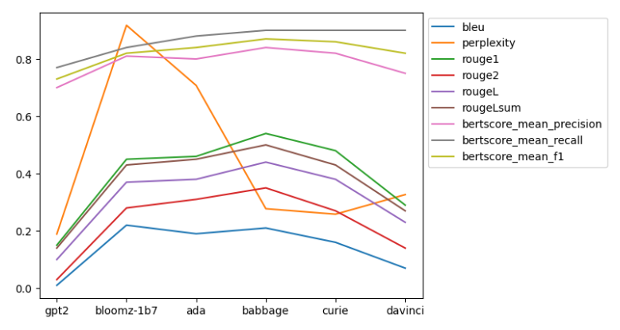
Results - Quantitative
 | gpt2 | bloomz-1b7 | ada | babbage | curie | davinci
bleu | 0.01 | 0.22 | 0.19 | 0.21 | 0.16 | 0.07
perplexity | 18.88 | 91.76 | 70.76 | 27.74 | 25.82 | 32.66
rouge1 | 0.15 | 0.45 | 0.46 | 0.54 | 0.48 | 0.29
rouge2 | 0.03 | 0.28 | 0.31 | 0.35 | 0.27 | 0.14
rougeL | 0.1 | 0.37 | 0.38 | 0.44 | 0.38 | 0.23
rougeLsum | 0.14 | 0.43 | 0.45 | 0.5 | 0.43 | 0.27
bertscore_mean_precision | 0.7 | 0.81 | 0.8 | 0.84 | 0.82 | 0.75
bertscore_mean_recall | 0.77 | 0.84 | 0.88 | 0.9 | 0.9 | 0.9
bertscore_mean_f1 | 0.73 | 0.82 | 0.84 | 0.87 | 0.86 | 0.82

Slide 13

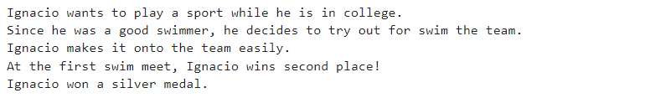
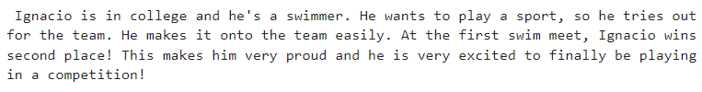
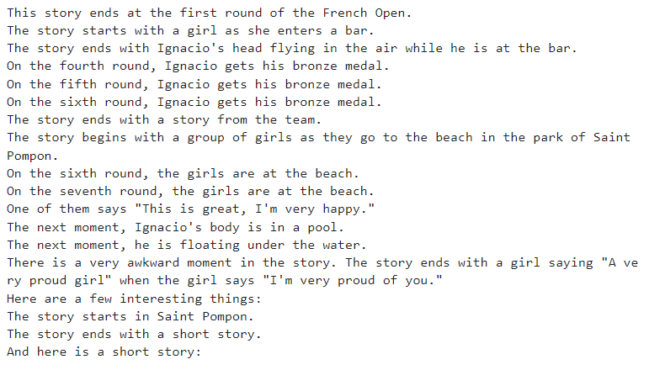
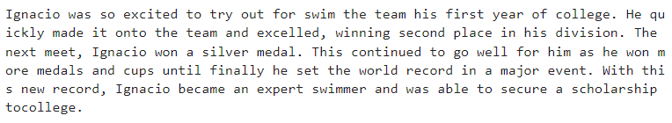
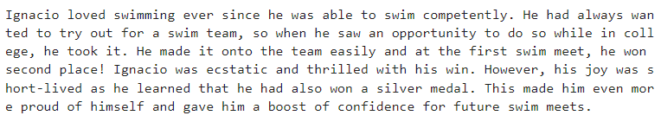
Results – Qualitative
Bloomz-1B7
Outline
Ada
GPT-2
Babbage
Curie

Slide 14
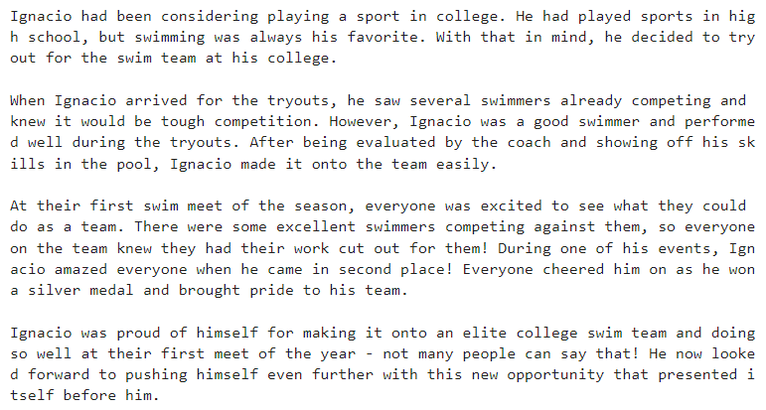
Results – Qualitative Contd.
Davinci
Outline

Slide 15
Conclusion & Future Works
Conclusions
Best Model for Story Generation
Quantitative Metrics for Story Generation
Future Works
Benchmark against Other Models
Benchmark against Existing Approaches
Use Better Evaluation Metrics

Slide 16
Thank You

